Slide 1
Tổng quan về công nghệ Java
GV: ThS. Phan Nguyệt Minh
minhpn@uit.edu.vn
http://courses.uit.edu.vn

Slide 2
Nội dung
Lịch sử phát triển
Công nghệ Java
Các dạng chương trình Java
Đặc điểm của Java
Máy ảo Java (Java Virtual Machine)
Viết, dịch, thực thi chương trình HelloWorld
Môi trường, công cụ: giới thiệu một số IDE phổ biến

Slide 3


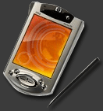



Lịch sử phát triển
1991: Sun Microsystems phát triển OAK nhằm mục đích viết phần mềm điều khiển (phần mềm nhúng) cho các sản phẩm gia dụng.
1995: internet bùng nổ, phát triển mạnh. Sun phát triển OAK và giới thiệu ngôn ngữ lập trình mới tên Java
Java là ngôn ngữ hướng đối tượng tựa C, C++

Slide 4
Lịch sử phát triển Java Development Kit (JDK)
Môi trường phát triển và thực thi do Sun Microsystems cung cấp (http://java.sun.com)
Bao gồm phần mềm và công cụ giúp compile, debug and execute ứng dụng.
JDK 1.0 - 1996
JDK 1.1 - 1997
JDK 1.2 (Java 2) - 1998
JDK 1.3 - 2000
Java 1.4 - 2002
Java 5 (1.5) - 2004
Java 6 - 2006
Java SE 7 - 2011
Java SE 8 - 2014

Slide 5
Java Development Kit (JDK)
Bao gồm
javac Chương trình dịch chuyển mã nguồn sang bytecode
java Bộ thông dịch: Thực thi java application
appletviewer Bộ thông dịch: Thực thi java applet mà không cần sử dụng trình duyệt như Nestcape, hay IE, v.v.
javadoc Bộ tạo tài liệu dạng HTML từ mã nguồn và chú thích

Slide 6
Java Development Kit (JDK)
Bao gồm
jdb Bộ gỡ lỗi (java debuger)
javap Trình dịch ngược bytecode

Slide 7
Công nghệ Java
Công nghệ:
Ngôn ngữ lập trình
Môi trường thực thi và triển khai
Môi trường phát triển
Công nghệ J2SE (Java 2 Standard Edition)
Công nghệ J2EE (Java 2 Enterprise Edition)
Công nghệ J2ME(Java 2 Micro Edition)

Slide 8
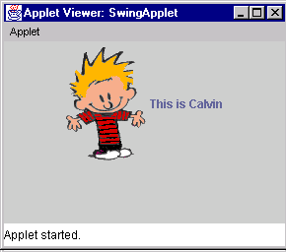
Các dạng chương trình Java
Applets

Slide 9
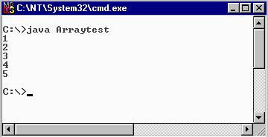
Các dạng chương trình Java (tt)
Console Applications

Slide 10
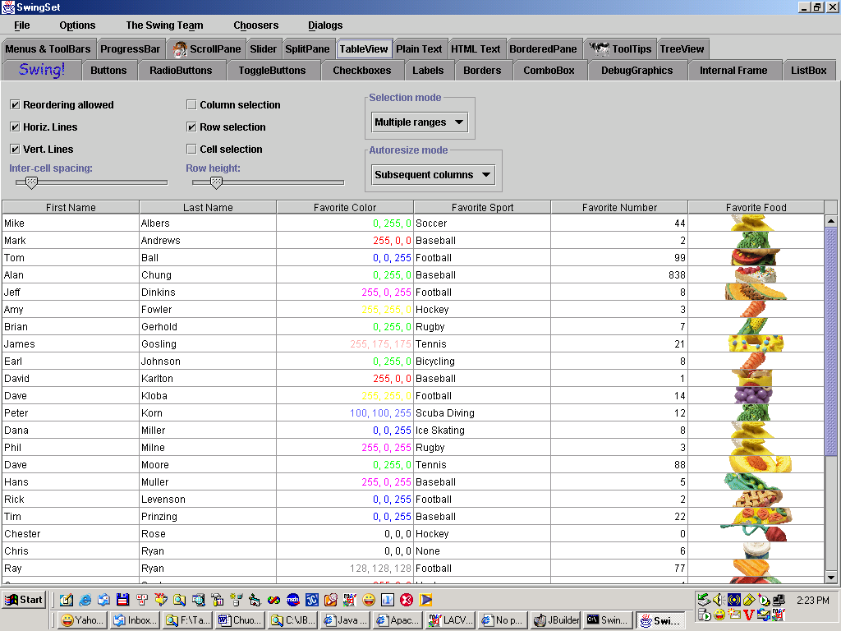
Các dạng chương trình Java (tt)
Ứng dụng Desktop

Slide 11
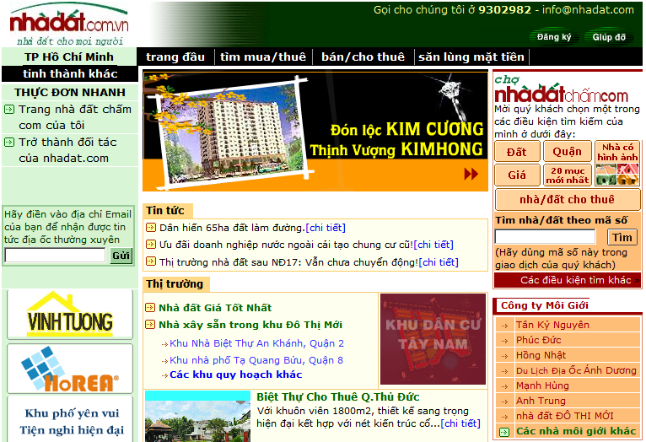
Các dạng chương trình Java (tt)
Ứng dụng Web

Slide 12
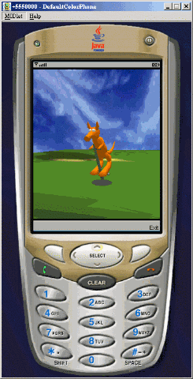
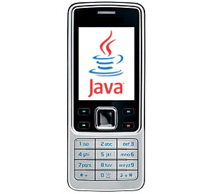
Các dạng chương trình Java (tt)
Một dạng phần mềm nhúng

Slide 13
Đặc điểm Java
Tựa C++, hướng đối tượng hoàn toàn.
Khả chuyển, độc lập nền.
Thông dịch (vừa biên dịch vừa thông dịch).
Cơ chế giải phóng bộ nhớ tự động.
An toàn, bảo mật.

Slide 14
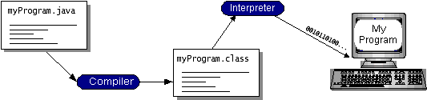
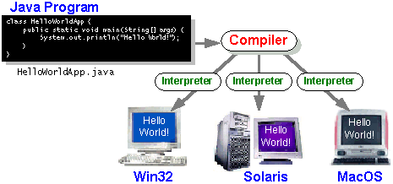
Dịch và thực thi chương trình Java

Slide 15
Java Virtual Machine
Là phần mềm dựa trên cơ sở máy tính ảo.
Có thể xem như 1 hệ điều hành thu nhỏ.
Cung cấp môi trường thực thi cho chương trình java (độc lập nền)
Hình thành 1 lớp trừu tượng:
Phần cứng máy tính bên dưới
Hệ điều hành
Mã đã biên dịch
Chương trình java chỉ chạy khi có JVM
JVM đọc và thực thi từng câu lệnh java

Slide 16
Giải phóng bộ nhớ (Garbage Collection)
Java cung cấp một tiến trình mức hệ thống để theo dõi việc cấp phát bộ nhớ
Garbage Collection
Đánh dấu và giải phóng các vùng nhớ không còn được sử dụng
Được tiến hành tự động
Cơ chế hoạt động phụ thuộc vào các phiên bản máy ảo

Slide 17
Môi trường, công cụ
Môi trường phát triển và thực thi của Sun – JDK 8
IDE (Integrated Development Enviroment)
Jcreator Pro 5.10
NetBeans 8.2
Eclipse 4.7
JBuilder 2008
IntelliJ IDEA Community Edition, Android Studio, Enide Studio 2014, BlueJ, jEdit, jGRASP, Jsource, Jdeveloper, DrJava,…
Notes:
NetBeans is an open source Integrated Development Environment written in Java and is one of IDR Solutions’ favourite IDEs for Java coding.
The NetBeans IDE supports development of all Java application types (Java SE, JavaFX, Java ME, web, EJB and mobile applications) out of the box. NetBeans is modular in design meaning it can be extended by third party developers who can create plugins for NetBeans to enhance functionality (Our PDF Plugin for NetBeans is a good example).
The NetBeans IDE can be used to develop in Java, but also supports other languages, in particular PHP, C/C++, and HTML5.
NetBeans features include an Ant-based project system, support for Maven, refactoring, version control (supporting CVS, Subversion, Git, Mercurial and Clearcase) and is also released under a dual license consisting of the Common Development and Distribution License (CDDL) v1.0 and the GNU General Public License (GPL) v2.
NetBeans is cross-platform and runs on Microsoft Windows, Mac OS X, Linux, Solaris and other platforms supporting a compatible JVM.
NetBeans can also be used for working with Cloud applications, this useful guide covers how to use the NetBeans IDE with the Google App Engine.
If you would like to find out more about NetBeans we have a series of articles which includes lots of tips and tutorials.
Eclipse
Eclipse is another free Java IDE for developers and programmers and it is mostly written in Java. Eclipse lets you create various cross platform Java applications for use on mobile, web, desktop and enterprise domains.
Its main features include a Windows Builder, integration with Maven, Mylyn, XML editor, Git client, CVS client, PyDev, and it contains a base workspace with an extensible plug-in system for customizing the IDE to suit your needs. Through plugins you can develop applications in other programming languages some of which include C, C++, JavaScript,, Perl, PHP, Prolog, Python, R, Ruby (including Ruby on Rails framework), to name just a few.
Eclipse is available under the Eclipse Public License and is available on Windows, Mac OS X and Linux.
IntelliJ IDEA Community Edition
IntelliJ IDEA Community Edition is a free Java IDE (Integrated Development Environment) mainly used for Android app development, Scala, Groovy, Java SE and Java programming. It is lightweight in design and comes with useful features like JUnit testing, TestNG, debugging, code inspections, code completion, support for multiple refactoring, Maven build tools, ant, visual GUI builder and code editor for XML and Java.
There are some features missing from the Community Edition but if you require more you can buy a license to unlock all the features.
IntelliJ Idea Community Edition is is released under the Apache 2 License.
Android Studio
Android Studio from Google is mainly designed for developing on the Android Platform. However it is capable of running and editing some Java code.
Originally it was built on the IntelliJ IDEA Community Edition created by JetBrains, and features a Flexible Gradle-based build system, build variants and multiple APK generation, Expanded template support for Google Services and various device types, Rich layout editor with support for theme editing and Lint tools to catch performance, usability, version compatibility, and other problems.
It also comes with ProGuard and app-signing capabilities and also features Built-in support for Google Cloud Platform and projects can be configured to use Java Development Kit (JDK) 6 or JDK 7.
Android Studio is freely available under the Apache License 2.0 and it is available for download on Windows, Mac OS X and Linux and replaced Eclipse as Google’s primary IDE for native Android application development.
Enide Studio 2014
Enide Studio 2014 (version 0.11-preview) was initially released as a stand-alone product for all operating systems. However later changes saw it develop a Tool Suite for Node.js, JavaScript and Java Development which is available from the Eclipse plugin store and from the main website.
Enide Studio 2014 Plugin includes: – Nodeclipse 0.17, – Chrome Development Tools, AngularJS for Eclipse, TernIDE, Eclipse WTP WebResources, TCF Terminals, MarkDown (*.md) Editor, – GitHub Flavored Markdown (GFM) Viewer, various themes, Nodeclipse EditBox, RestClient Tool. StartExplorer, Git Add-on, Maven, Gradle integration, Minimalist Jade Editor and more..
BlueJ
BlueJ is an integrated development environment (IDE) for the Java programming language. It has been mainly developed for educational purposes, but is also suitable for those who wish to do small-scale software development. It runs with the help of a JDK (Java Development Kit).
BlueJ is mainly developed for the teaching of object-oriented programming, and its design differs from other development environments as a result.
The main screen graphically shows the class structure of an application under development and objects can be interactively created and tested. This interaction facility, combined with a clean, simple user interface, allows easy experimentation with objects under development and this allows beginners to get started more quickly, and without being overwhelmed.
Newbie users can check values and call methods on them, pass them as parameters and more and Java expressions can be invoked without compiling meaning BlueJ is a powerful graphical shell/REPL for Java.
The BlueJ project is free and open source software, licensed under GNU GPL with the classpath exception and there are popular textbooks designed for teaching introductory university/college courses with BlueJ, and a site full of teaching resources and is also can run on Windows, Mac OS X, Linux and other platforms which run Java. It can also run without installation from a USB stick.
jEdit
jEdit is a text editor with hundreds (counting the time developing plugins) of person-years of development behind it. Most people argue where jEdit beats many expensive development tools for features and ease of use is that the jEdit core comes with a built-in macro language; an extensible plugin architecture. Hundreds of macros and plugins are available.
There is also an auto indent function, and syntax highlighting for more than 200 languages, support for a large number of character encodings including UTF8 and Unicode, folding for selectively hiding regions of text, Word wrap, and more.
It can also be used for source code editing, search and replacing, file management. jEdit is written in Java, so it runs on Mac OS X, OS/2, Unix, VMS and Windows, and it is released as free software with full source code, provided under the terms of the GPL 2.0.
jGRASP
jGRASP is a lightweight IDE primarily created for automatic generation of software visualizations to improve the comprehensibility of software. It is capable of producing static visualizations of source code structure and visualizations of data structures at runtime and jGRASP produces Control Structure Diagrams (CSDs) for Java, C, C++, Objective-C, Python, Ada, and VHDL; Complexity Profile Graphs (CPGs) for Java and Ada; UML class diagrams for Java; and has dynamic object viewers and a viewer canvas that work in conjunction with an integrated debugger and workbench for Java.
The viewers have a built in feature that allows it to identify data structures which allows it to recognize objects that represent traditional data structures such as stacks, queues, linked lists, binary trees, and hash tables and display this appropriately.
jGRASP is implemented in Java and was developed by the Department of Computer Science and Software Engineering in the Samuel Ginn College of Engineering at Auburn University.
It can run on any platform that can run a Java Virtual Machine (Java version 1.5 or higher). At present the jGRASP web site offers downloads for Windows, Mac OS, and as a generic ZIP file suitable for Linux and other systems.
JSource
JSource is a free Java IDE and is a good option for Java developers and programmers.
It is useful for creating cross-platform Java applications for various domains and is extremely lightweight. You can use JSource to run, compile, edit and create Java files. Its main features are syntax highlighting for multiple languages and Java Swing components. In version 2.0 of JSource you can use jEdit syntax packages and can incorporate other open source Java tools used for rapid development. These tools have been modified to work with the core JSource structure.
JSource is available under a GNU General Public License version 2.0 (GPLv2).
JDeveloper
JDeveloper is an IDE supplied by the Oracle Corporation and released as freeware. It offers various features for development in Java, XML, SQL and PL/SQL, HTML, JavaScript, BPEL and PHP. JDeveloper can be used for coding, debugging, optimization and profiling to deploying. JDeveloper integrates with the Oracle Application Development Framework (Oracle ADF) – an end-to-end Java EE-based framework that further simplifies application development.
JDeveloper comes in 3 flavors which include the Java Edition, J2EE edition and Studio Edition which comes with a whole different set of features.
In terms of the Java Edition what is included out of the box is Java SE 6 Support, Code Editor, Code Navigation, Refactoring, compatibility with Swing,Unit Testing, Version Control, Auditing & Metrics,Debugging, Profiling,Ant Support, Maven Support,XML Support and Open API & Extensions.
The same IDE platform also serves as the basis of another Oracle product, SQL Developer.
DrJava
DrJava is an extremely lightweight development environment that can be used for writing Java programs. It has been designed primarily for students, and provides an intuitive interface and the ability to interactively evaluate Java code.
Its main feature are for it to be used as a unit testing tool, a source level debugger, an interactive pane for evaluating text of the program, intelligent program editor and can be used for more depending on your requirements. It is available for free under the BSD License, and it is under active development by the JavaPLT group at Rice University.
Hopefully you’ve found this guide on the best IDE’s for Programming, developing and coding Java useful.

Slide 18
Chương trình Hello World
Dùng Notepad soạn thảo đoạn lệnh bên dưới và lưu lại với tên HelloWorld.java
Khai báo thư viện java.io
Định nghĩa lớp tên “HelloWorld”
import java.io.*;
public class HelloWorld
{
public static void main(String args[])
{
System.out.print("Hello World");
}
}
Phương thức main
Bắt đầu đoạn lệnh
Xuất ra Console thông báo
Kết thúc đoạn lệnh

Slide 19
Chương trình Hello World (tt)
Biên dịch: dùng chương trình javac
C:\> javac HelloWorld.java
Biên dịch thành công tạo ra tập tin có đuôi .class (HelloWorld.class)
Thông dịch (thực thi): dùng chương trình java
C:\> java HelloWorld

Slide 20
Chương trình Hello World (tt)
Lưu ý: Phải khai báo đường dẫn chỉ đến thư mục cài đặt java, và thư mục chứa các class cần thực thi
Ví dụ:
C:\> set path=C:\jdk1.5\bin\
C:\> set classpath = D:\ThucHanhJava\BT1\

Slide 21
Chương trình Hello World (tt)
TestGreeting.java:
import java.io.*;
public class TestGreeting
{
public static void main(String[] args)
{
Greeting gr = new Greeting();
gr.greet();
}
}
Greeting.java:
public class Greeting
{
public void greet()
{
System.out.print("Hello World");
}
}

Slide 22
Chương trình Hello World (tt)
Biên dịch TestGreeting.java
javac TestGreeting.java
Greeting.java được biên dịch tự động
Thực hiện
java TestGreeting
Kết quả
Hello World

Slide 23
Java Applets
Được nhúng trong một ứng dụng khác (web browser)
Có giao diện hạn chế (đồ họa)
Không truy cập được tài nguyên của client

Slide 24
Applet đơn giản
Welcome.java:
// Java packages
import java.awt.Graphics;
import java.applet.Applet;
public class Welcome extends Applet
{
public void paint(Graphics g)
{
// call superclass version of method paint
super.paint(g);
// draw a String
g.drawString(”Welcome to Java programming!”, 25, 25);
}
}

Slide 25
Nhúng vào trang web
<html>
<applet code = "Welcome.class"
width = "300" height = "45">
</applet>
</html>

Slide 26
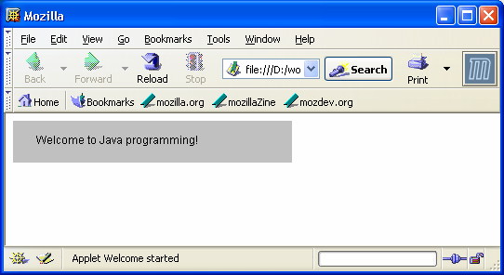
Thực hiện (trong web browser)

Slide 27
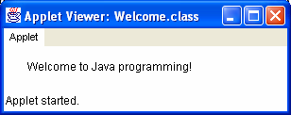
Thực hiện
appletviewer Welcome.html

Slide 28
Q/A

